Slide 1
Introduction to
STRUCTURED QUERY LANGUAGE
BY:
IFFAT FARZANA ANJUM
DBS
IIUI

Slide 2
Introduction to SQL
The history of SQL begins in an IBM laboratory in San Jose, California, where SQL was developed in the late 1970s.
  1970 -- Dr. E. F. "Ted" of IBM is known as the father of relational databases. He described a relational model
  for databases.
  1974 -- Structured Query Language appeared.
  1978 -- IBM worked to develop Codd's ideas and released a product named System/R.
  1986 -- IBM developed the first prototype of relational database and standardized by ANSI. The first relational
  database was released by Relational Software and its later becoming Oracle.
The initials stand for Structured Query Language, and the language itself is often referred to as "sequel.“
In fact, SQL makes an RDBMS possible.
SQL is a nonprocedural language, in contrast to the procedural or third-generation languages
SQL is an ANSI (American National Standards Institute) standard, but there are many different versions of the SQL language.
SQL is the standard language for Relation Database System. All relational database management systems like MySQL, MS Access, Oracle, Sybase, Informix, postgres and SQL Server use SQL as standard database
language.
Notes:
Nonprocedural means what rather than how. For example, SQL describes what data to retrieve, delete, or insert, rather than
how to perform the operation.

Slide 3
SQL is the de facto standard language used to manipulate and retrieve data from these relational databases. SQL enables a programmer or database administrator to do the following:
  Modify a database's structure
  Change system security settings
  Add user permissions on databases or tables
  Query a database for information
  Update the contents of a database
The standard SQL commands to interact with relational databases are CREATE, SELECT, INSERT, UPDATE, DELETE and DROP.
These commands can be classified into groups based on their nature:
1- DDL - Data Definition Language:
Command Description
CREATE Creates a new table, a view of a table, or other object in database
ALTER Modifies an existing database object, such as a table.
DROP Deletes an entire table, a view of a table or other object in the database.
TRUNCATE - remove all records from a table, including all spaces allocated for the records are removed
COMMENT - add comments to the data dictionary
RENAME - rename an object
Notes:
Data Definition Language (DDL) statements are used to define the database structure or schema.

Slide 4
2- DML - Data Manipulation Language:
Command Description
INSERT Creates a record
UPDATE Modifies records
DELETE Deletes records
SELECT - retrieve data from the a database
MERGE - UPSERT operation (insert or update)
CALL - call a PL/SQL or Java subprogram
EXPLAIN PLAN - explain access path to data
LOCK TABLE - control concurrency
3- DCL - Data Control Language:
Command Description:
GRANT Gives a privilege to user
REVOKE Takes back privileges granted from user
4- DQL - Data Query Language:
Command Description:
SELECT Retrieves certain records from one or more tables
Notes:
Data Manipulation Language (DML) statements are used for managing data within schema objects.
Transaction Control (TCL) statements are used to manage the changes made by DML statements. It allows statements to be grouped together into logical transactions.

Slide 5
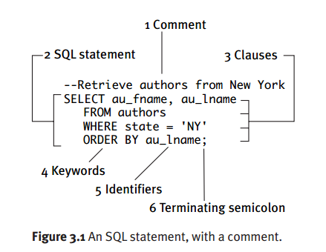
SQL Syntax
Comment. A comment is optional text that explains your program. Comments usually describe what a program does and how, or why code was changed.
  SQL statement. An SQL statement is a valid combination of tokens introduced by a keyword.
  Tokens are the basic indivisible particles of the SQL language; they can’t be reduced grammatically.
  Tokens include keywords, identifiers, operators, literals (constants), and punctuation symbols.
Clauses. An SQL statement has one or more clauses.
  In general, a clause is a fragment of an SQL statement that’s introduced by a keyword, is required or optional, and must be given in a particular order.
  SELECT, FROM, WHERE, and ORDER BY introduce the four clauses in this example.
Keywords. Keywords are words that SQL reserves because they have special meaning in the language.
Identifiers. Identifiers are words that you (or the database designer) use to name database objects such as tables, columns, aliases, indexes, and views.
au_fname, au_lname, authors, and state are the identifiers in this example.
Terminating semicolon. An SQL statement ends with a semicolon.

Slide 6
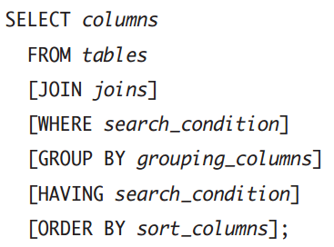
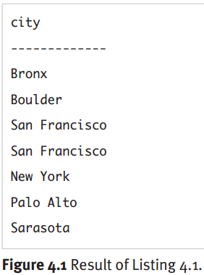
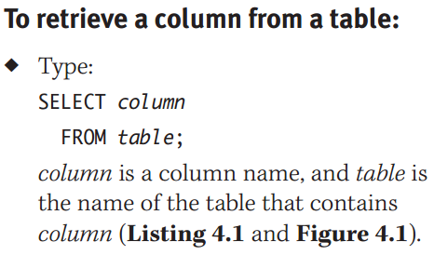
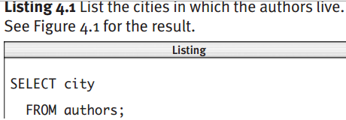
Retrieving Data from a Table
SELECT retrieves rows, columns, and derived values from one or more tables in a database; its syntax is:

Slide 7
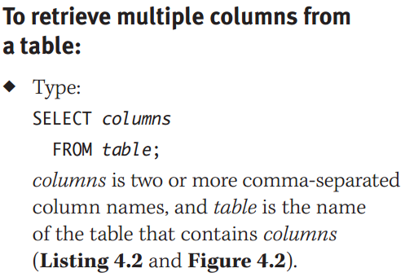
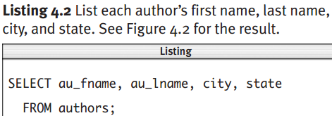
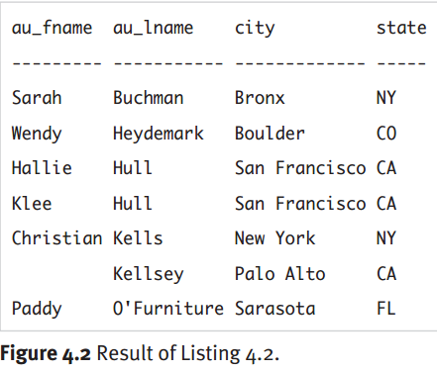
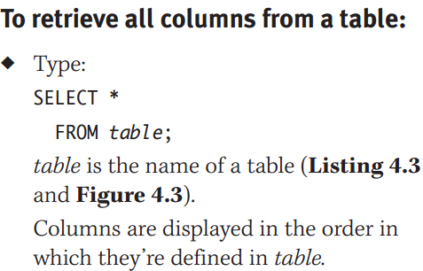
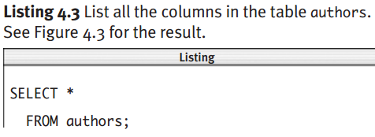

Slide 8
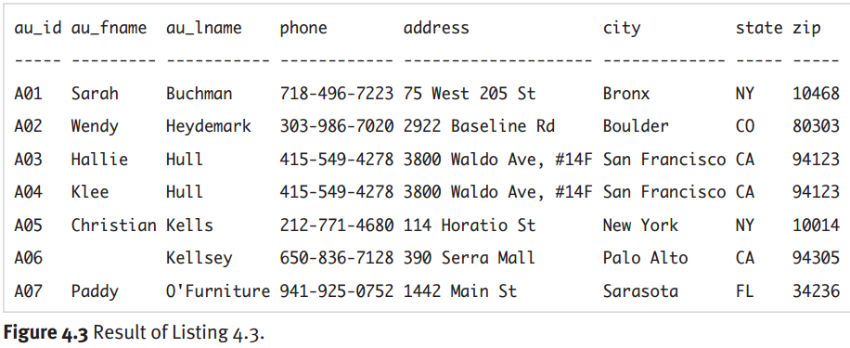

Slide 9
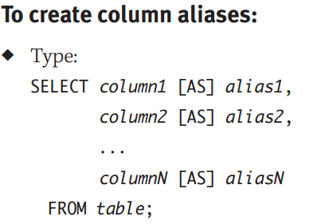
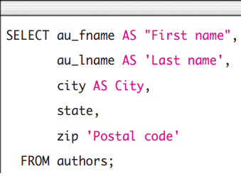
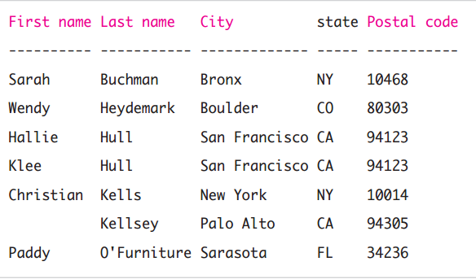
Creating Column Aliases with AS
A column’s default heading in a result is the source column’s name in the table definition.
A column alias is an alternative name (identifier) that you specify to control how column headings are displayed in a result.

Slide 10
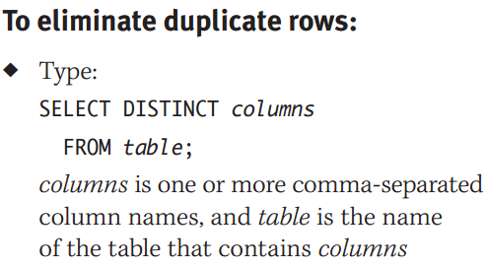





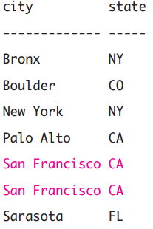

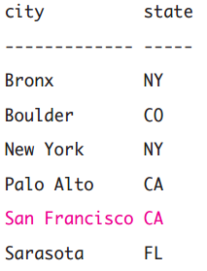
Eliminating Duplicate Rows with DISTINCT

Slide 11
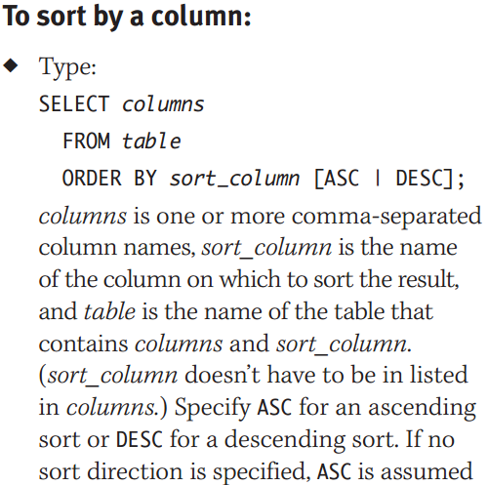
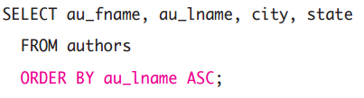
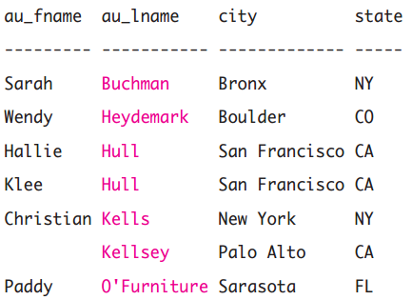
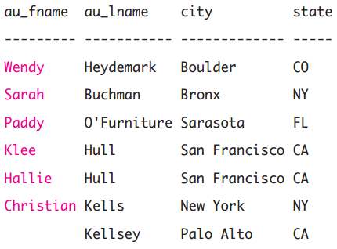
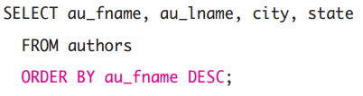
Sorting Rows with ORDER BY

Slide 12
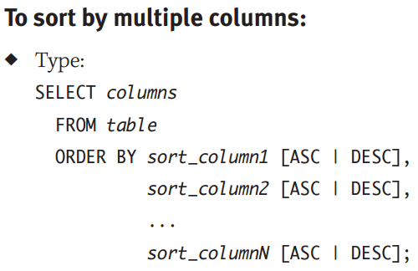
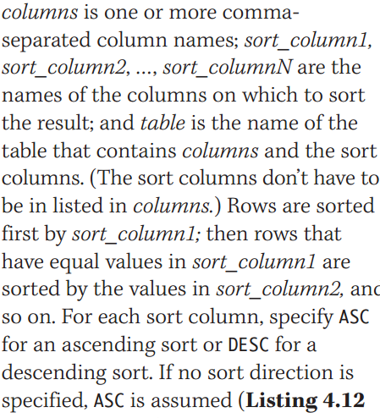

Slide 13
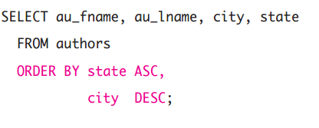
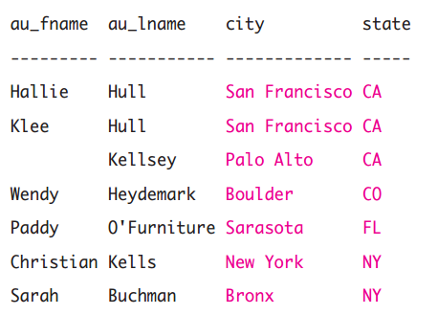
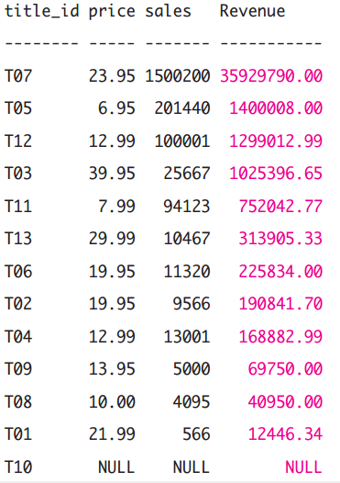
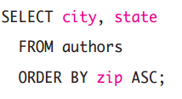
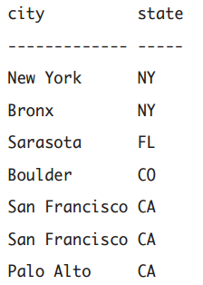
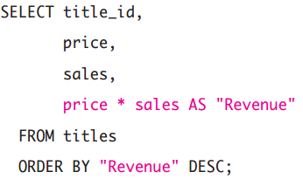

Slide 14
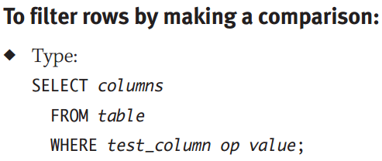
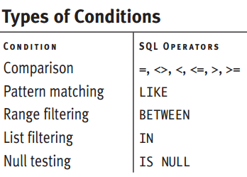
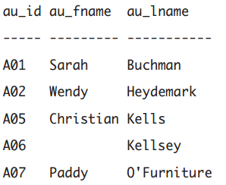
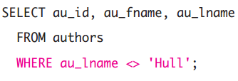
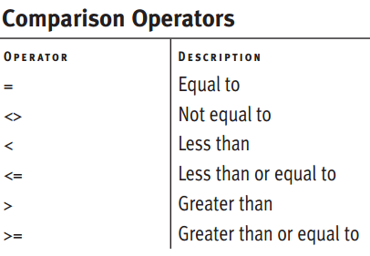
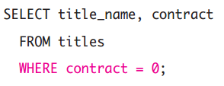
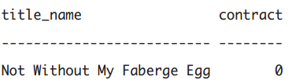
Filtering Rows with WHERE

Slide 15
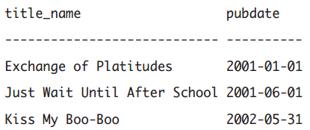
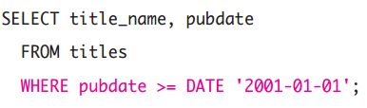
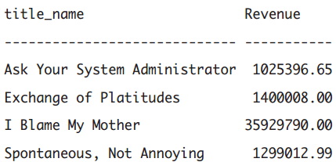
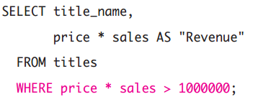

Slide 16
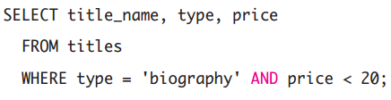
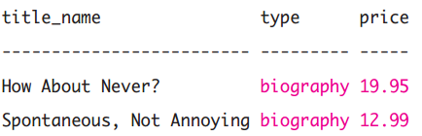
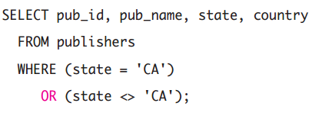
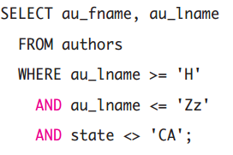
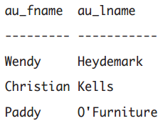
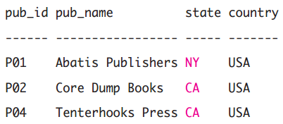
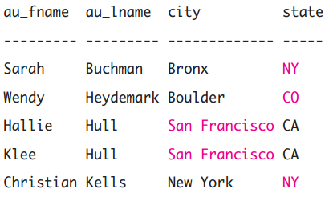
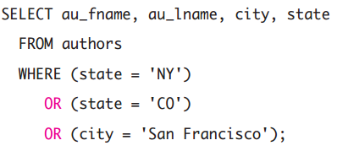
Combining and Negating Conditions with AND, OR, and NOT

Slide 17
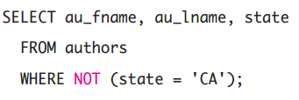








Slide 18



Matching Patterns with LIKE

Slide 19










Slide 20


Slide 21




Range Filtering with BETWEEN
Use BETWEEN to determine whether a given value falls within a specified range. BETWEEN works with character strings, numbers, and datetimes.

Slide 22






Slide 23







List Filtering with IN
Use IN to determine whether a given value matches any value in a specified list. IN works with character strings, numbers, and datetimes. The IN list is a parenthesized listing of one or more comma-separated values.

Slide 24






Testing for Nulls with IS NULL
A null matches no value—not even other nulls. You can’t use = or <> to test whether a value is null.
LIKE, BETWEEN, IN, and other WHERE-clause conditions can’t find nulls because unknown values don’t satisfy specific conditions.

Slide 25






Slide 26


Operators and Functions
Creating Derived Columns
A derived column is the result of a calculation and is created with a SELECT-clause .
Derived columns don’t become permanent columns in a table; they’re for display and reporting purposes.

Slide 27




Performing Arithmetic Operations

Slide 28





Slide 29







Concatenating Strings with ||

Slide 30









Extracting a Substring with SUBSTRING()

Slide 31






Changing String Case with UCASE() and LCASE()

Slide 32






Trimming Characters with Ltrim & Rtrim
In Microsoft Access, the trimming functions are LTrim(string) to trim leading spaces,
RTrim(string) to trailing spaces, and Trim(string) to trim both leading and trailing spaces. Use the Replace(string, find, replacement [, start[, count[, compare]]]) function to trim nonspace characters (actually, to replace nonspaces with empty strings). Use + to concatenate strings.

Slide 33






Slide 34






Finding the Length of a String with len()

Slide 35





Finding Substrings with instr()
In Microsoft Access, the position function is InStr(start_position, string,substring)

